Slide 1
The hitchhiker's guide
to Puerto Rico
Harid López
Dara Guadalupe

Slide 2
Introduction
In this project, we were expected to use all the Data Science and Machine Learning skills we acquired during the course of the last few weeks to build an interactive travel planner for travelers visiting Puerto Rico. To this matter, we developed a working application that interacts with visitors and helps them build a travel itinerary suitable to their personal preferences.

Slide 3

The data
PR municipalities
PR landmarks
01
02
78 raw files
574 raw files
Extracted from wikipedia:
had a lot of noise
were difficult to clean

Slide 4
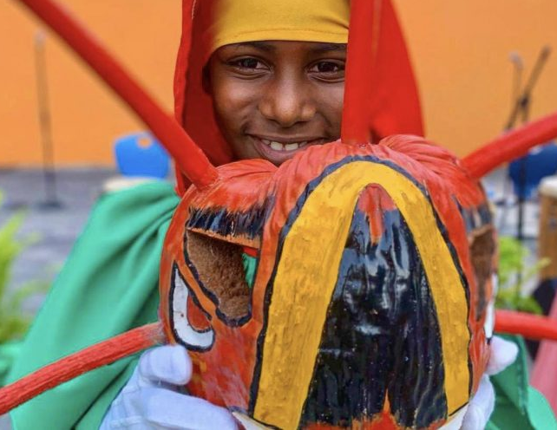
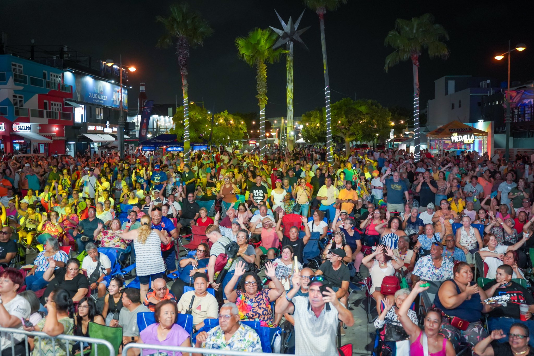
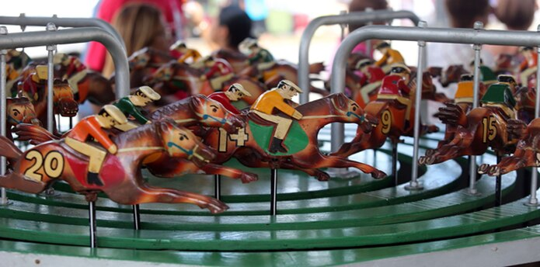
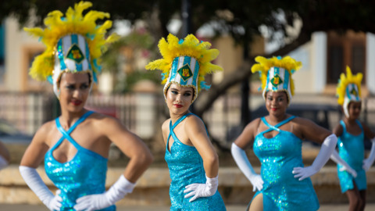
Extra data
Fiestas Patronales
03
The data was manually extracted from wikipedia, uploaded to a sheet and converted to CSV.

Slide 5
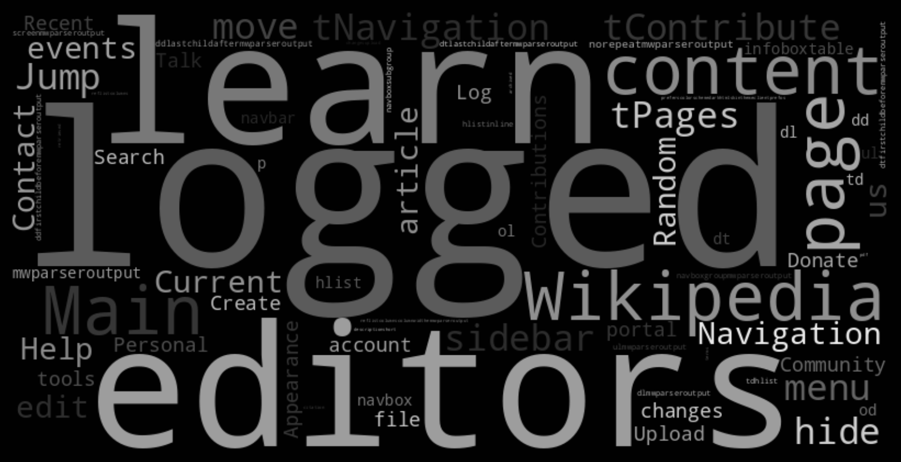
Extraction and cleaning
We retrieved coordinates from the data and from Geohack website.
We retrieved the summary using Wikipedia API.
We retrieved the weather information through OpenWeather API.
We dropped extra spaces and hyphens.

Slide 6
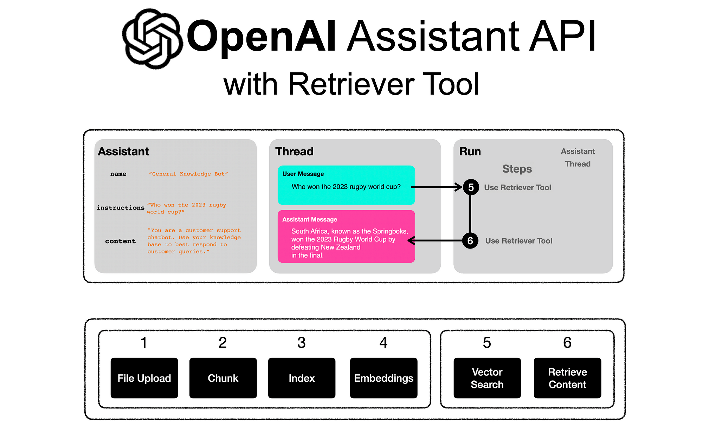
Embedding and Vector DB
Chunks: by rows
Embedding model: Ada-2
Created dictionaries
Convert to JSON
Vector DB: FAISS

Slide 7
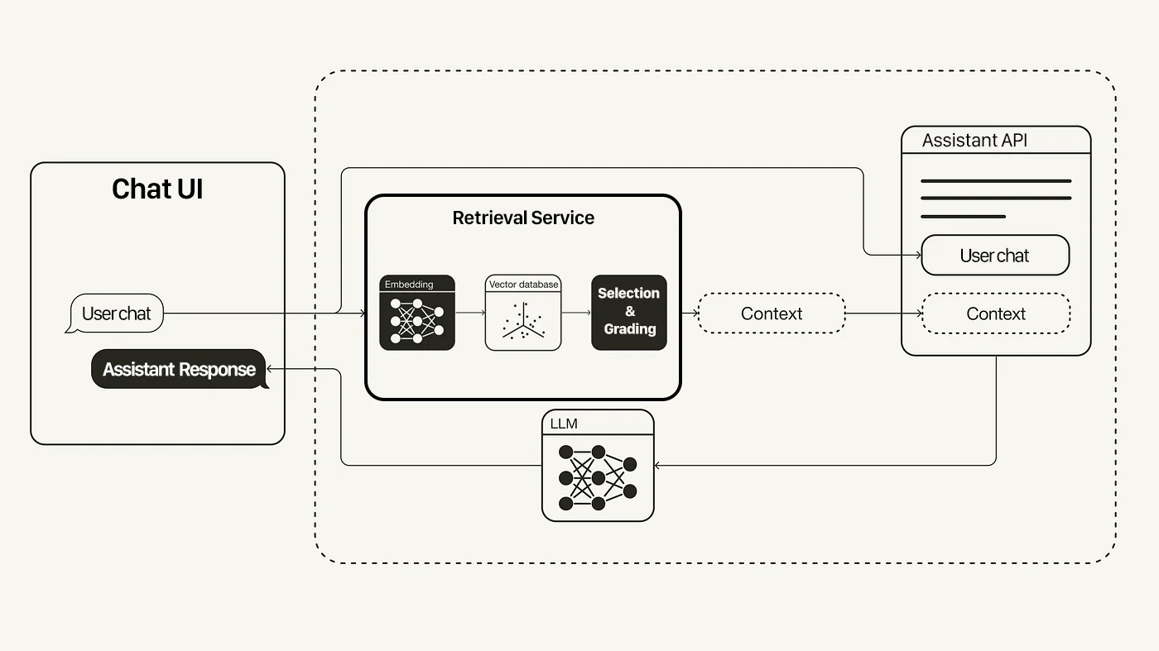
LLM
Model: OpenAi 3.5 Turbo
Instructions = "You are a friendly
assistant helping users plan their
trip to Puerto Rico. Ask them about
their travel dates, interests, and
preferred region, and suggest
relevant landmarks and festivals based on their responses."
Visual assessment: we evaluated our model for accurate and clean responses.

Slide 8
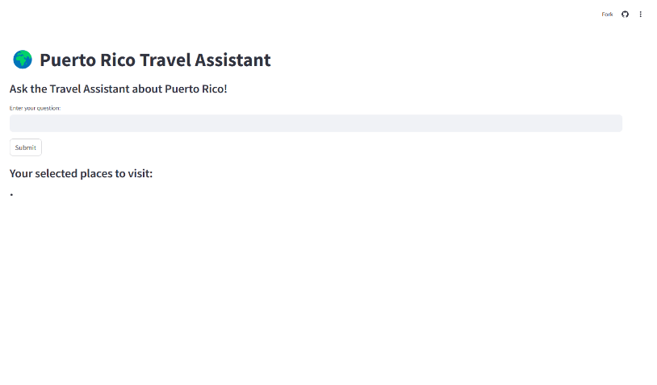
Our App… Demo Time!

Slide 9

Possible upgrades
Faster response time
Accessibility tools
Restaurant recommendations
Solo traveler pairing
Local business recommendations
Rating capabilities
Adding more landmarks, activities and festivals

Slide 10
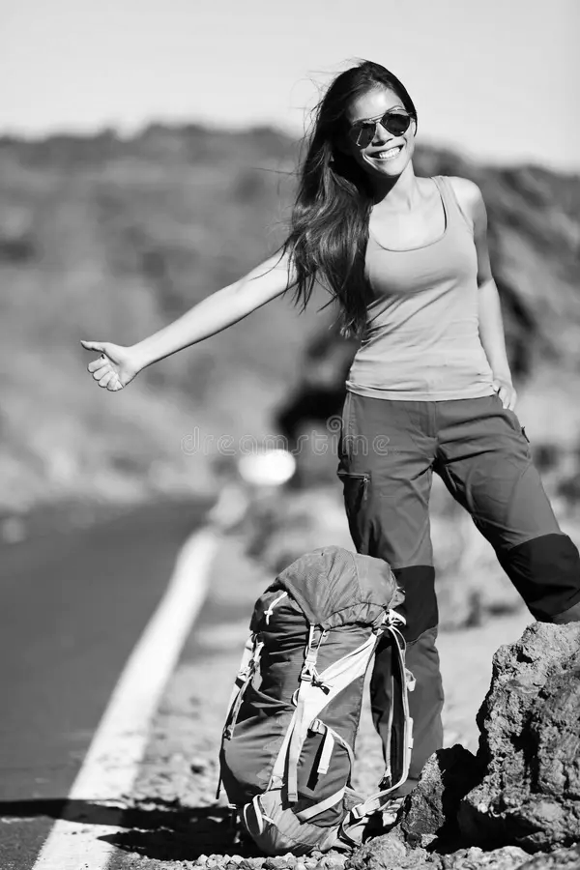
Benefits of using our App
User-friendly
Personalized Travel Suggestions
Real-Time Weather Updates
Great conversation flow with the
assistant
Top ML technology
These benefits combined ensure that our app is the
best tool for any hitchhiker exploring Puerto Rico!

Slide 11
Conclusion
Using the Data Science and Machine Learning knowledge gained during the the last few weeks, we were able to build an app that helps travelers plan their trip to Puerto Rico. Even though we did not achieve each part of the assignment, we are proud of our model and our app. We definitely acquired new skills while we were building the assistant and that is what we appreciate the most about this project.

Slide 12
Thanks!

